Slide 1
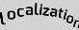
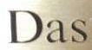



Albert Gordo
Lluís Gómez
1

Slide 2
Agenda
Introduction [10:00 – 10:10]
Scene-text Localization [10:10 – 10:55]
Theoretical introduction
Practical
Scene-text Recognition [10:55 – 11:40]
Theoretical introduction
Practical
Coffe break [11:40 – 12:00]
Scene-text Understanding [12:00 – 12:40]
Theoretical introduction
Practical
Closing Remarks [ 12:40 – 12:50]
Discussion [ 12:50 – 13:00]
2

Slide 3
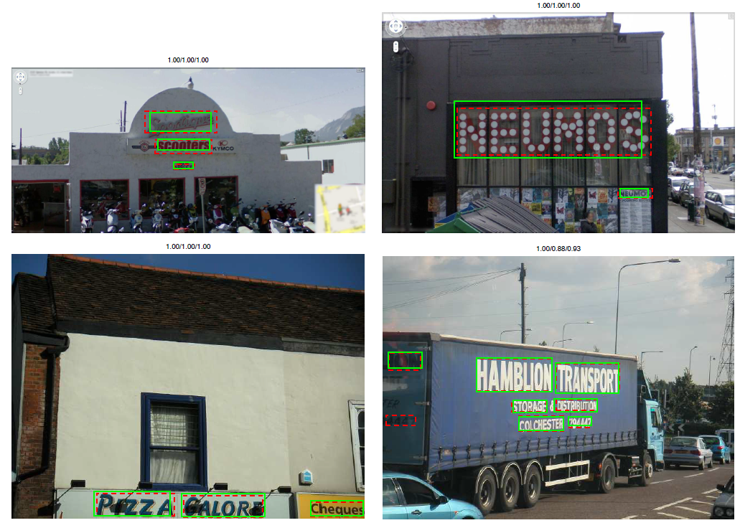
Localization
[Gomez’13, Gomez’14, Gomez’15, Jaderberg’15a...]
3

Slide 4
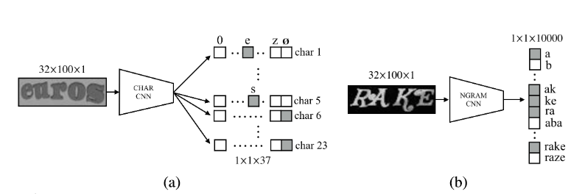
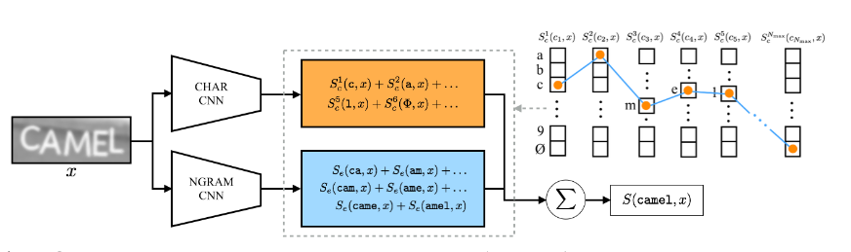
Recognition
[Almazán’14, Jaderberg’ 14, Gordo’15a, Jaderberg’15b, Shi’15, Shi’16, Lee’16…]
4

Slide 5
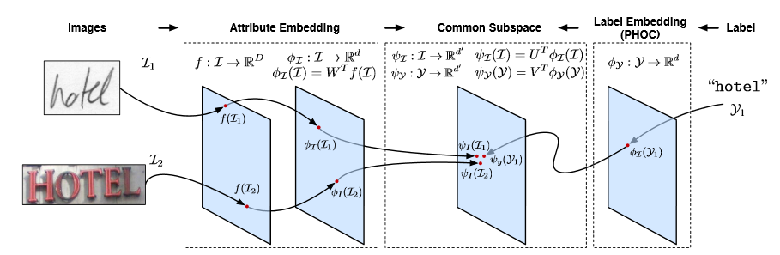
Matching
[Almazán’13, Rodriguez’13, Almazán’14, Rodriguez’15]
5

Slide 6

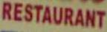
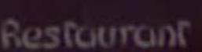
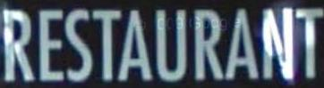
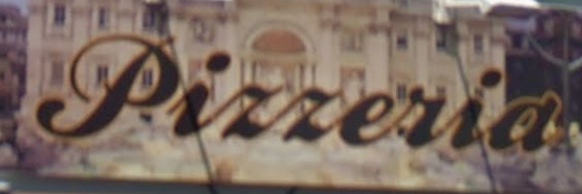
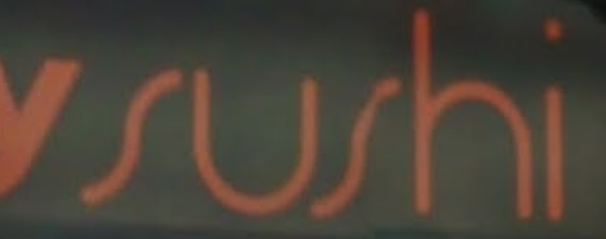

What about semantics?
Traditional method: considers only the exact word / string
Ideal: consider the potential meaning(s) of the word
6

Slide 7
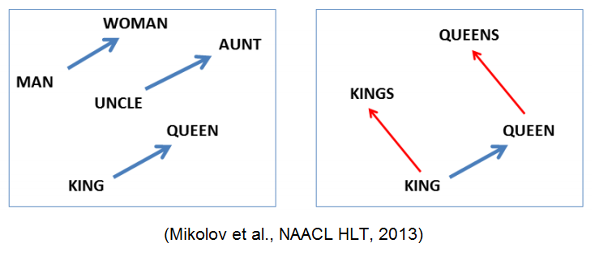
What about semantics?
Embeddings can encode semantics
Word embeddings and distributional semantic, e.g., Word2Vec, GloVe, and many others
[Mikolov’13]
7
Notes:
But, TU is also a fundamental aspect for SU, since text may provide very discriminative cues.
Recent methods are able to detect and segment the general classes of elements in a given scene. However, in many cases, if we want to fully understand the image and all the elements contained we need to extract and recognize the text contained. In this case, only by reading the text in this image we can recognize the different shops.

Slide 8
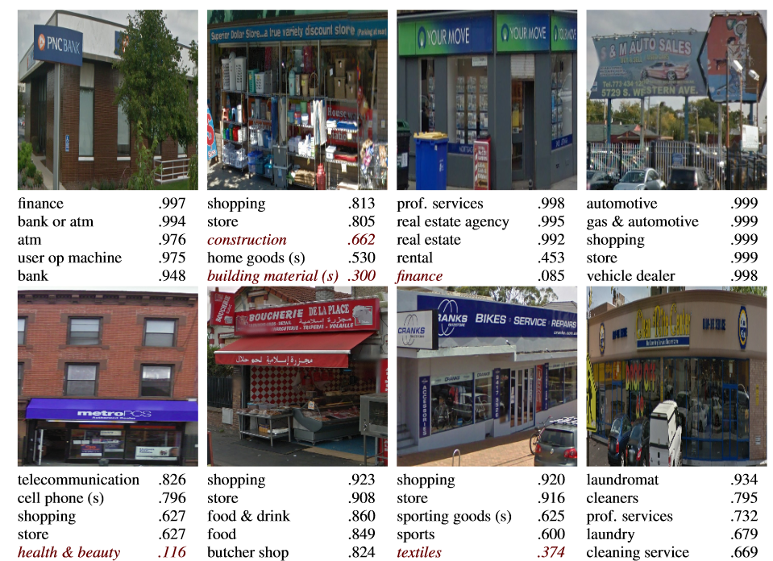
What about semantics?
Text helps in fine-grained categorization, even when no text annotations were provided:
[Movshovitz’15]
8
Notes:
But, TU is also a fundamental aspect for SU, since text may provide very discriminative cues.
Recent methods are able to detect and segment the general classes of elements in a given scene. However, in many cases, if we want to fully understand the image and all the elements contained we need to extract and recognize the text contained. In this case, only by reading the text in this image we can recognize the different shops.

Slide 9
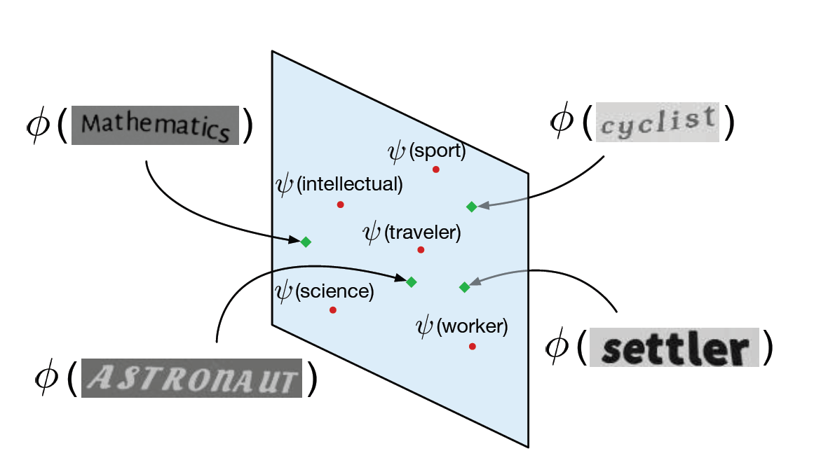
What about semantics?
Can we embed word images and semantic concepts in the same vectorial space?
9

Slide 10
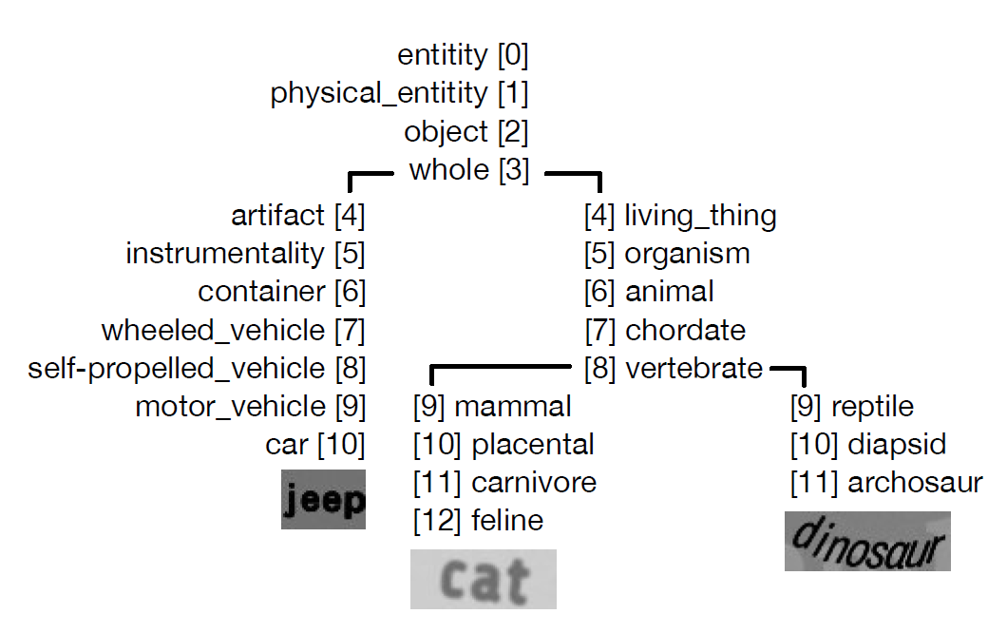
Mining Concepts from WordNet
10

Slide 11
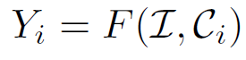
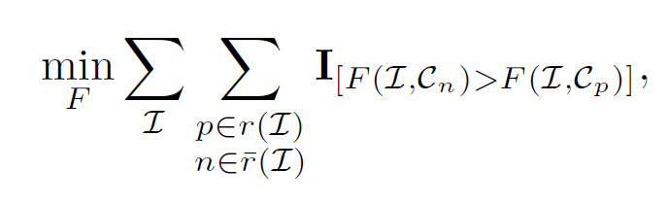
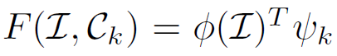
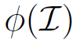
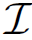
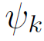
Objective
Define a compatibility function between images and concepts:
Minimize the number of misranked concepts:
Compatibility function is a dot product between embeddings:
Learned with a Convolutional Neural Network:
: activations of the previous-to-last layer given image
: weights of the last layer associated with concept
11

Slide 12
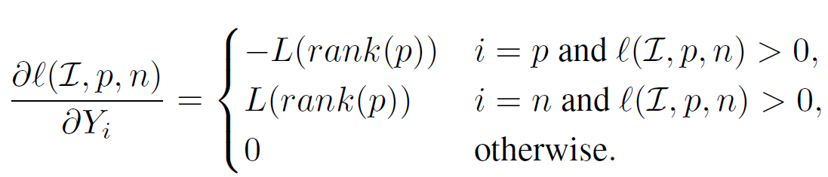
Differentiable Surrogate
WARP Ranking loss [Weston’11]
Indicator replaced with hinge loss
Triplet sampling
Loss weighting
Written in Python and integrated in Caffe [Caffe]
Same CNN architecture as [Jaderberg’14b, Jaderberg’15a]
Embeddings of 4096 dimensions
12

Slide 13
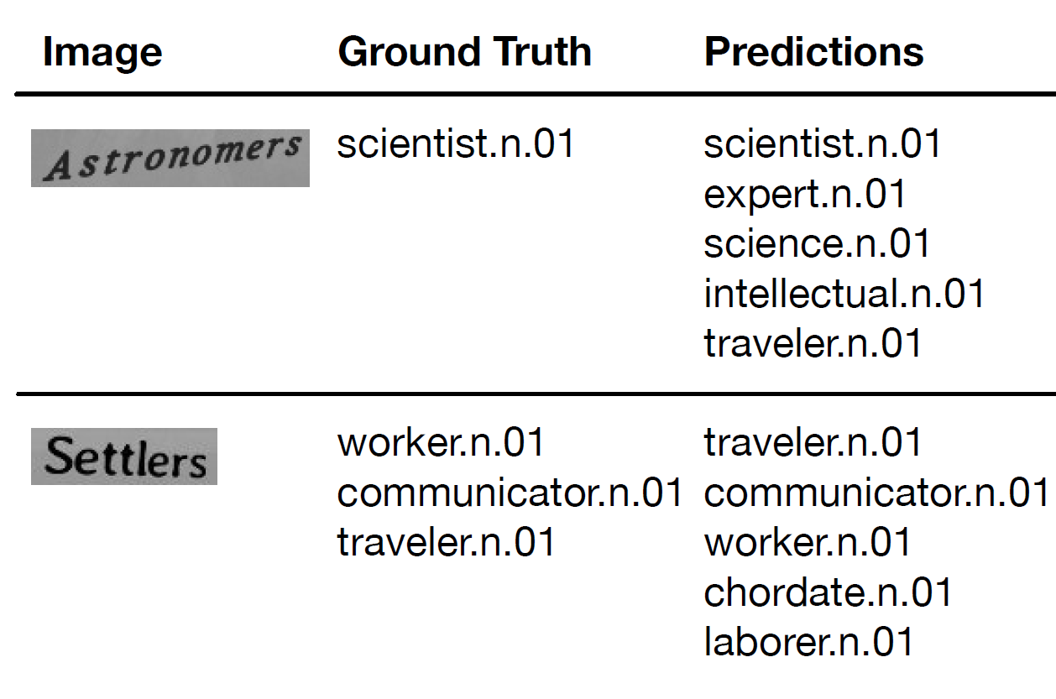
Image to Concept Qualitative Results
13

Slide 14
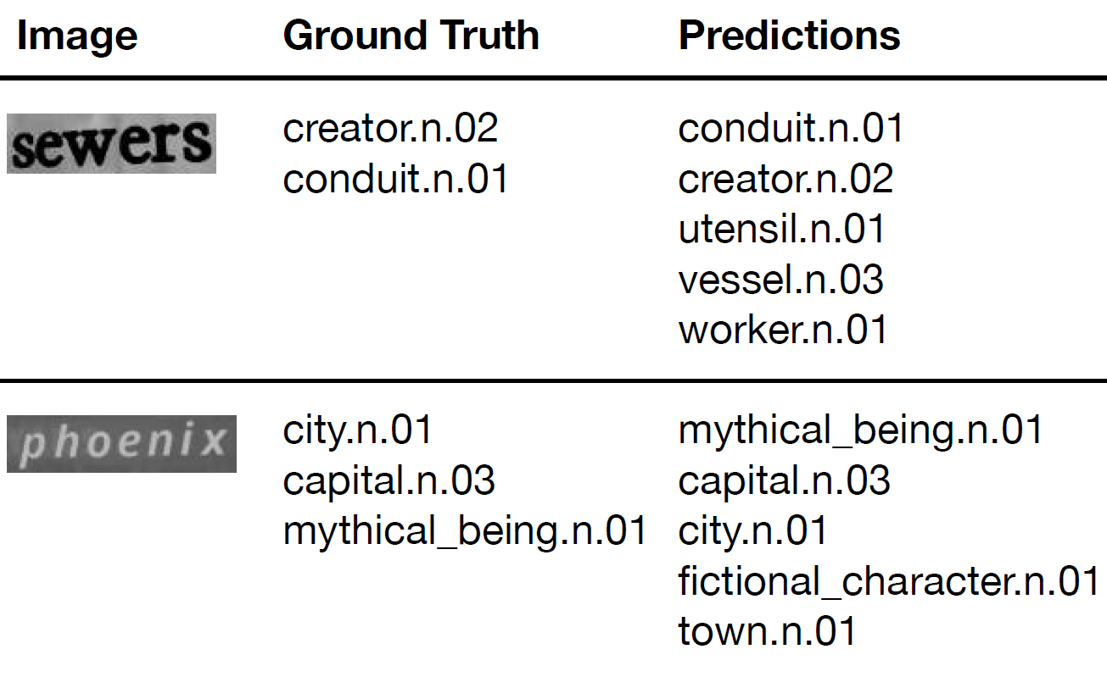
Image to Concept Qualitative Results
14

Slide 15
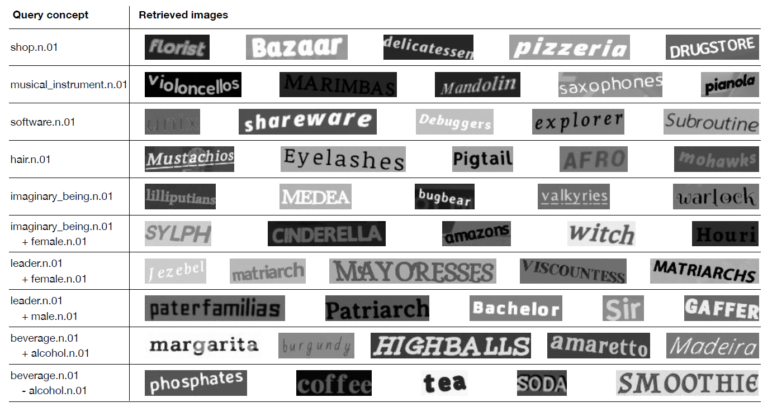
Concept to Image Qualitative Results
15

Slide 16
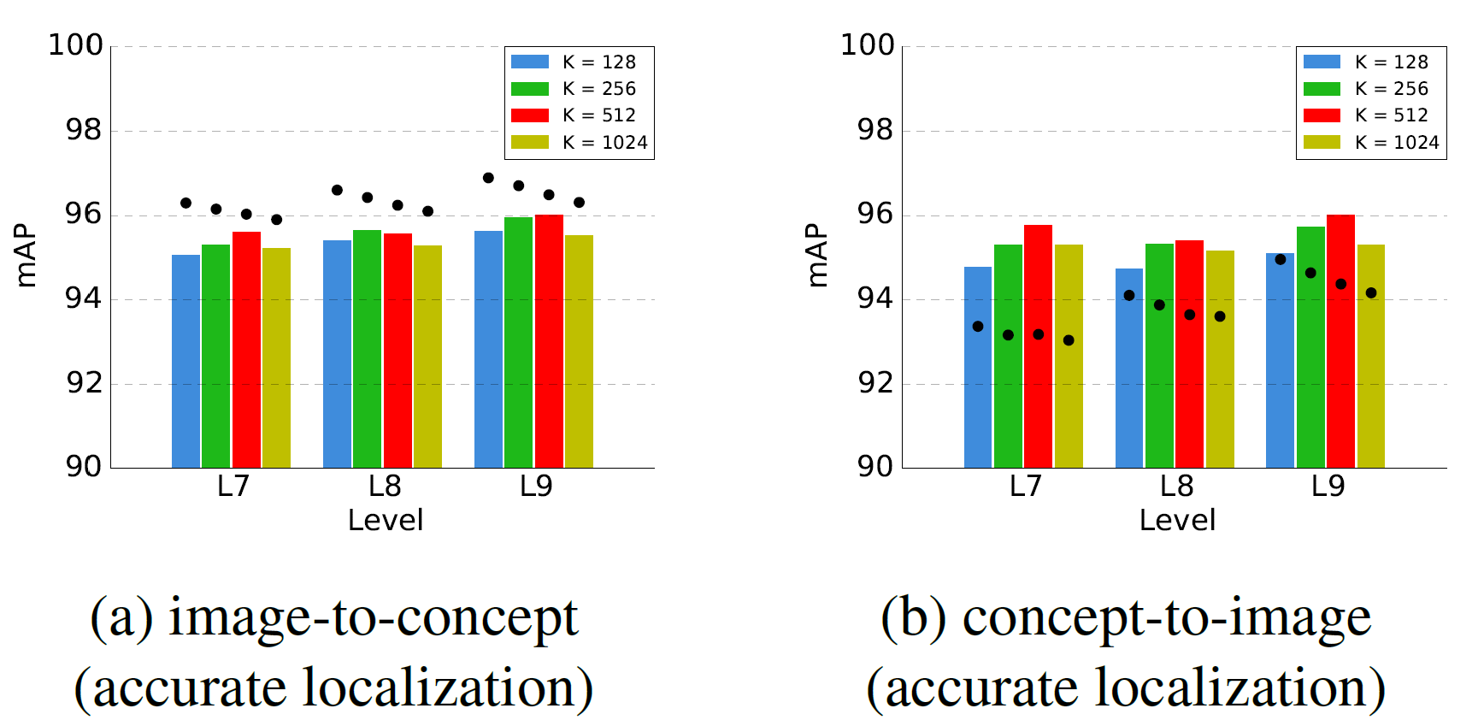
Quantitative Results (Oxford Synthetic)
Testing with words never seen during training (K=256, l=7):
Image-to-concept: 61.9% mAP
Concept-to-image: 52.8% mAP
16

Slide 17
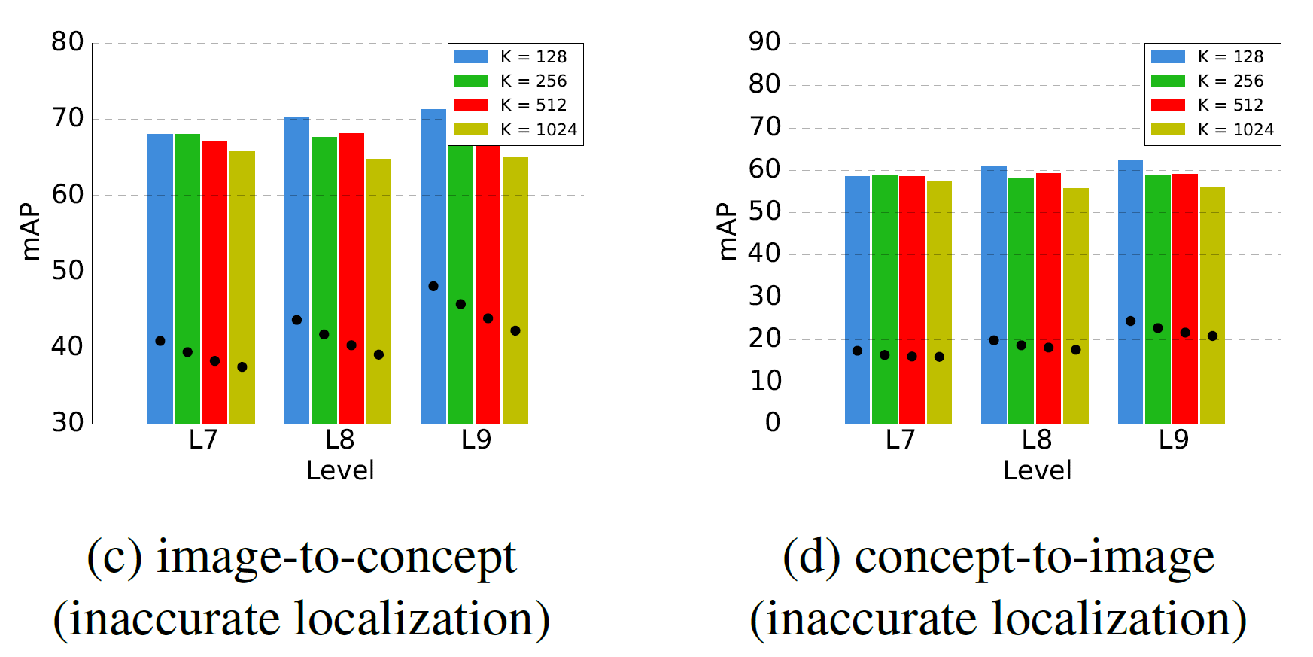
Quantitative Results (Oxford Synthetic)
Potential improvement: learn on badly cropped data
17

Slide 18
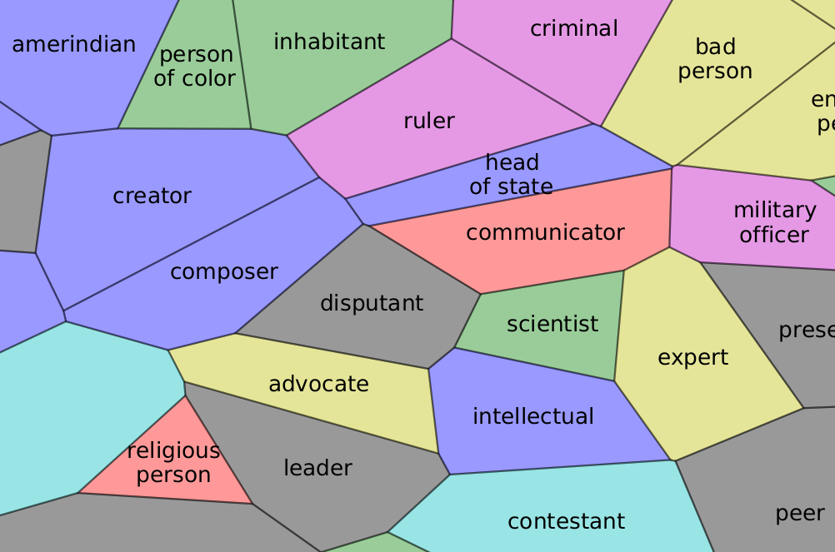
Visualizing the Concepts
Projection of concept embeddings in 2D using t-SNE
18

Slide 19
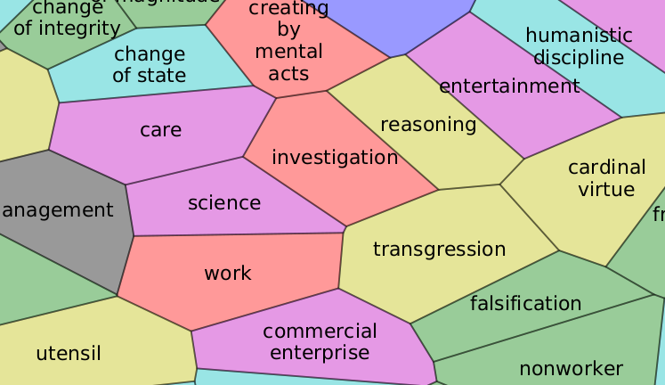
Visualizing the Concepts
Projection of concept embeddings in 2D using t-SNE
19

Slide 20
Conclusions
Traditional text in the wild tasks neglect semantics. Can a semantic embedding be learned directly from the image pixels? Yes
Semantic annotations mined from WordNet [Future work: distributional representations?]
Problem cast as a Convolutional Net with a ranking loss
Joint embedding of word images and semantic concepts
Quantitative results comparable to a two-step baseline
Generalization to unseen words
20

Slide 21

21

